Slide 1

One Minute Network
Snapshot of the most important daily news in beauty, fashion and finance that affects you and your wallet

Slide 2
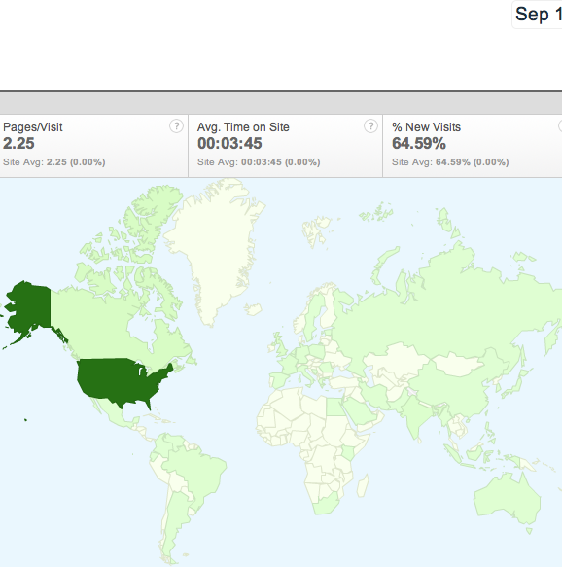
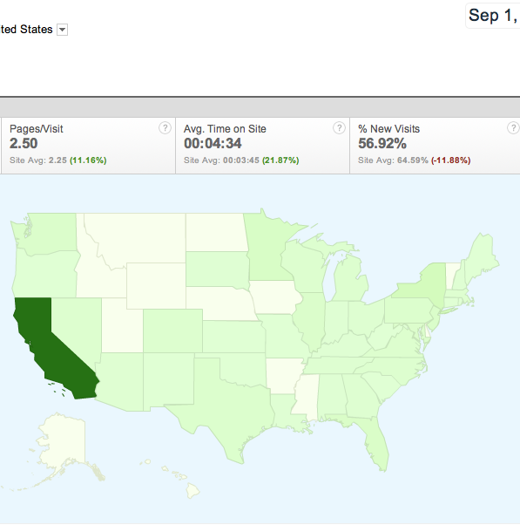
Market Assessment and Current Users
World
United States

Slide 3
Survey
Age: 18-39 - 68%
Sex: Male - 58%
Location: California - 92%
What stops you from reading financial news on a daily basis?
Not Enough Time - 56%
Not Interested in Finance - 25%

Slide 4



Competitors

Slide 5
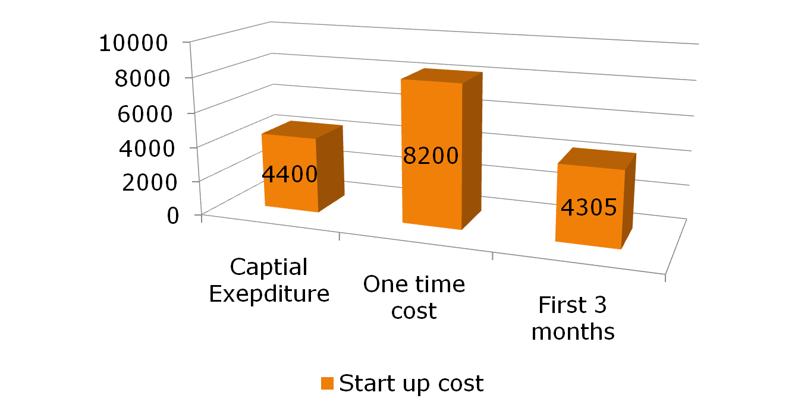
Summary of Startup Cost

